Slide 1
Objectives
How do interest groups attract members?
How do they influence government?
Are interest groups good for America? Consider your opinion in light of the arguments of Madison and De Tocqueville.

Slide 2
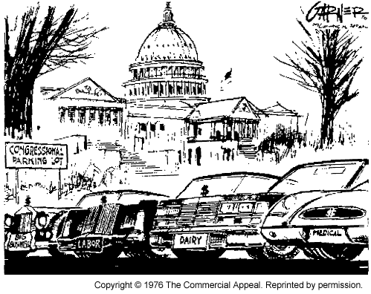
Interest Groups: Good or Bad?

Slide 3
Interest Groups Defined
Any group that seeks to influence public policy
  Synonym: pressure group, special interest groups

Slide 4
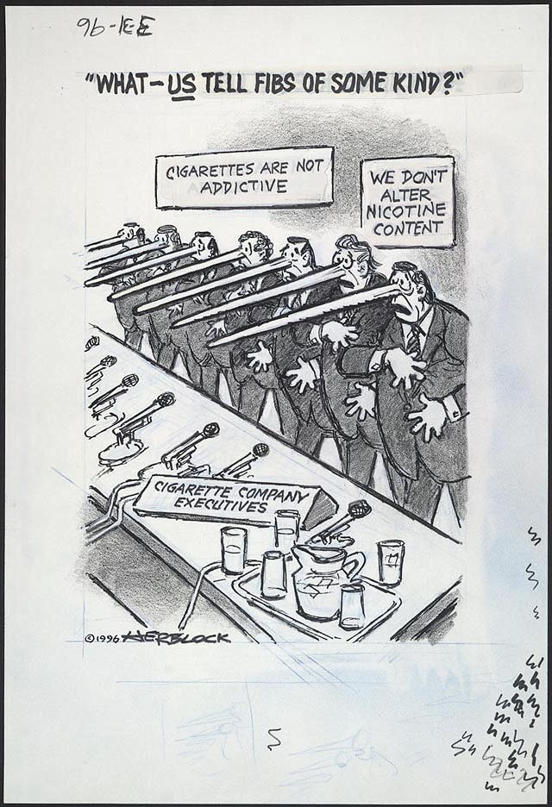

Slide 5
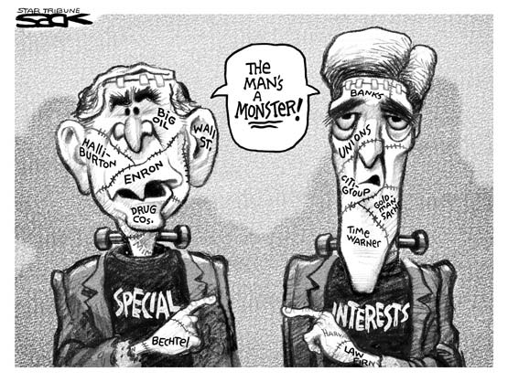

Slide 6
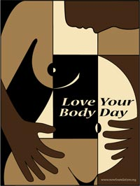
National Organization for Women
An abstract design by Atlanta art student Crystal Holiday was recently selected as the official poster for Love Your Body Day 2004

Slide 7
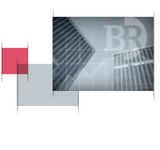
Business Roundtable
Business Roundtable is an association of chief executive officers of leading U.S. corporations with a combined workforce of more than 10 million employees in the United States. The Roundtable is committed to advocating public policies that ensure vigorous economic growth, a dynamic global economy, and the well-trained and productive U.S. workforce essential for future competitiveness
Examples of Members
Coca Cola
3M
Chevron/Texaco
Bristol Meyers Sqibb

Slide 8
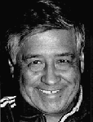
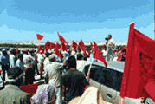
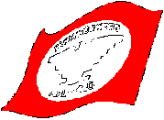
United Farm Workers
Cesar Chavez
founder
Si Se Puede
Union of farm workers, organizes
Thousands of farmworkers

Slide 9
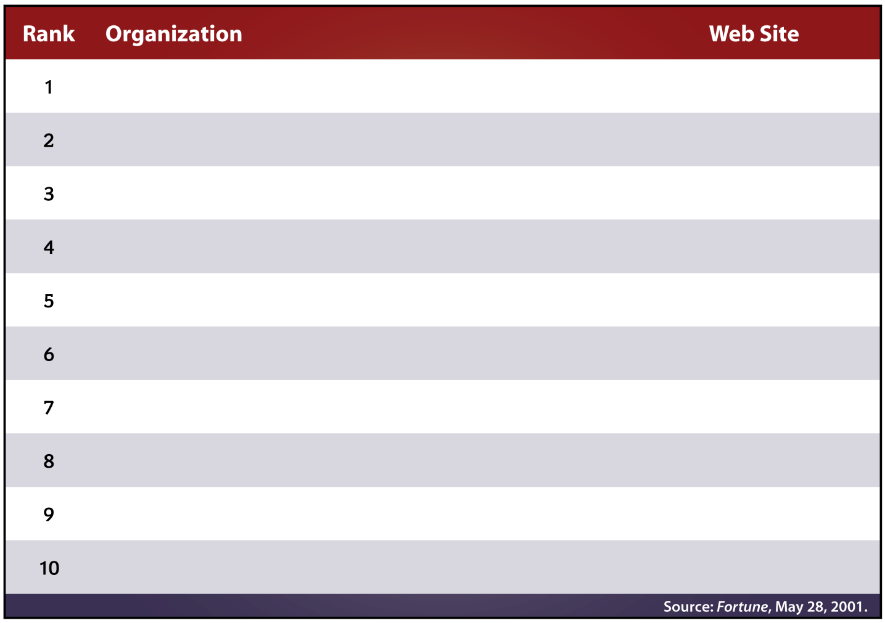
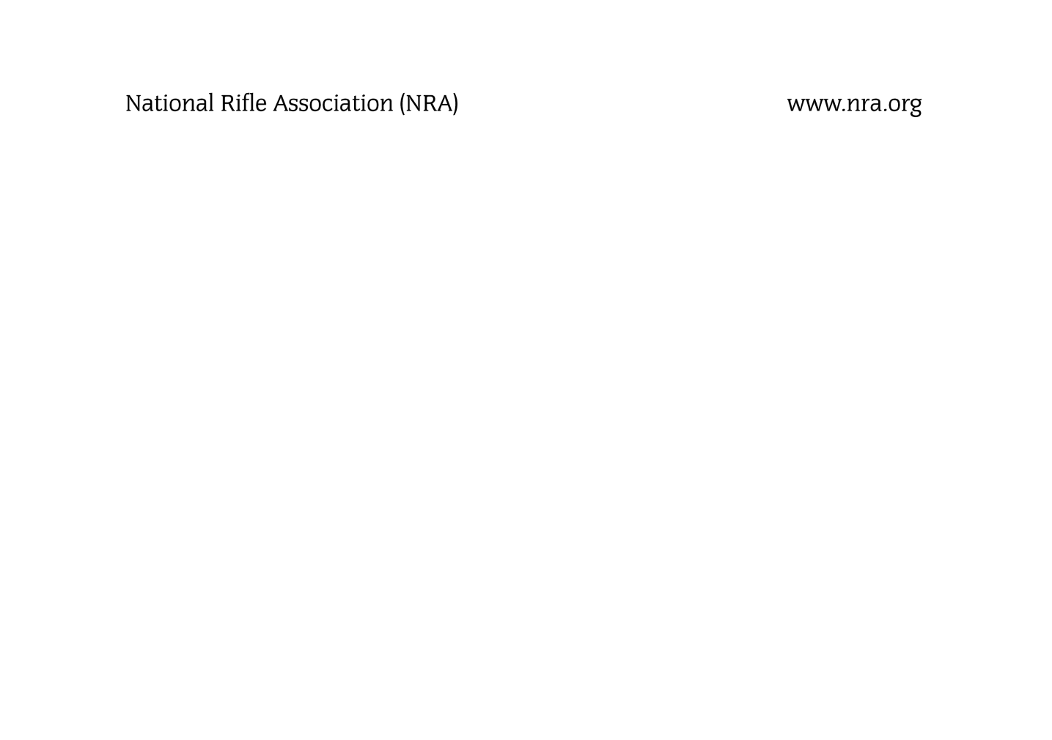

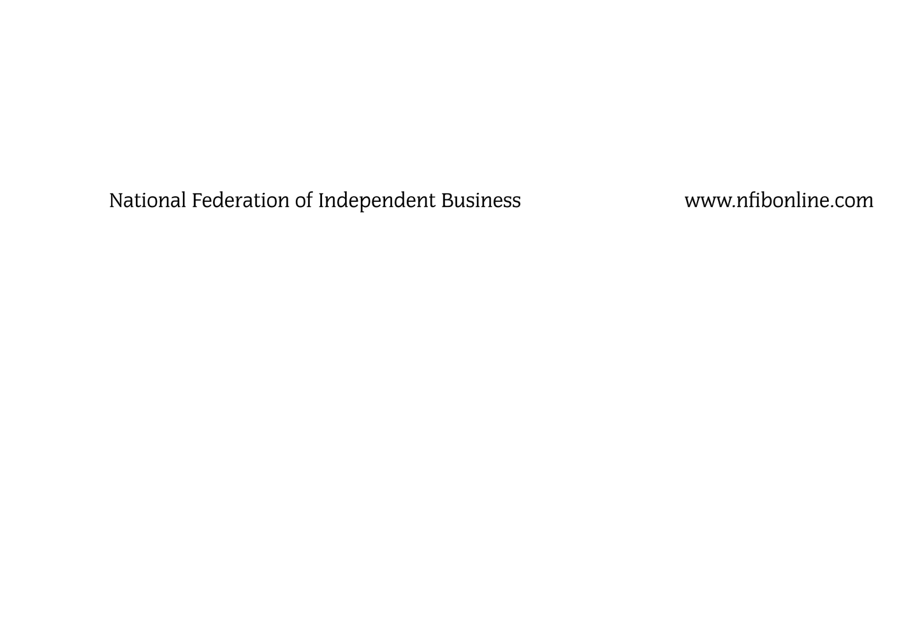
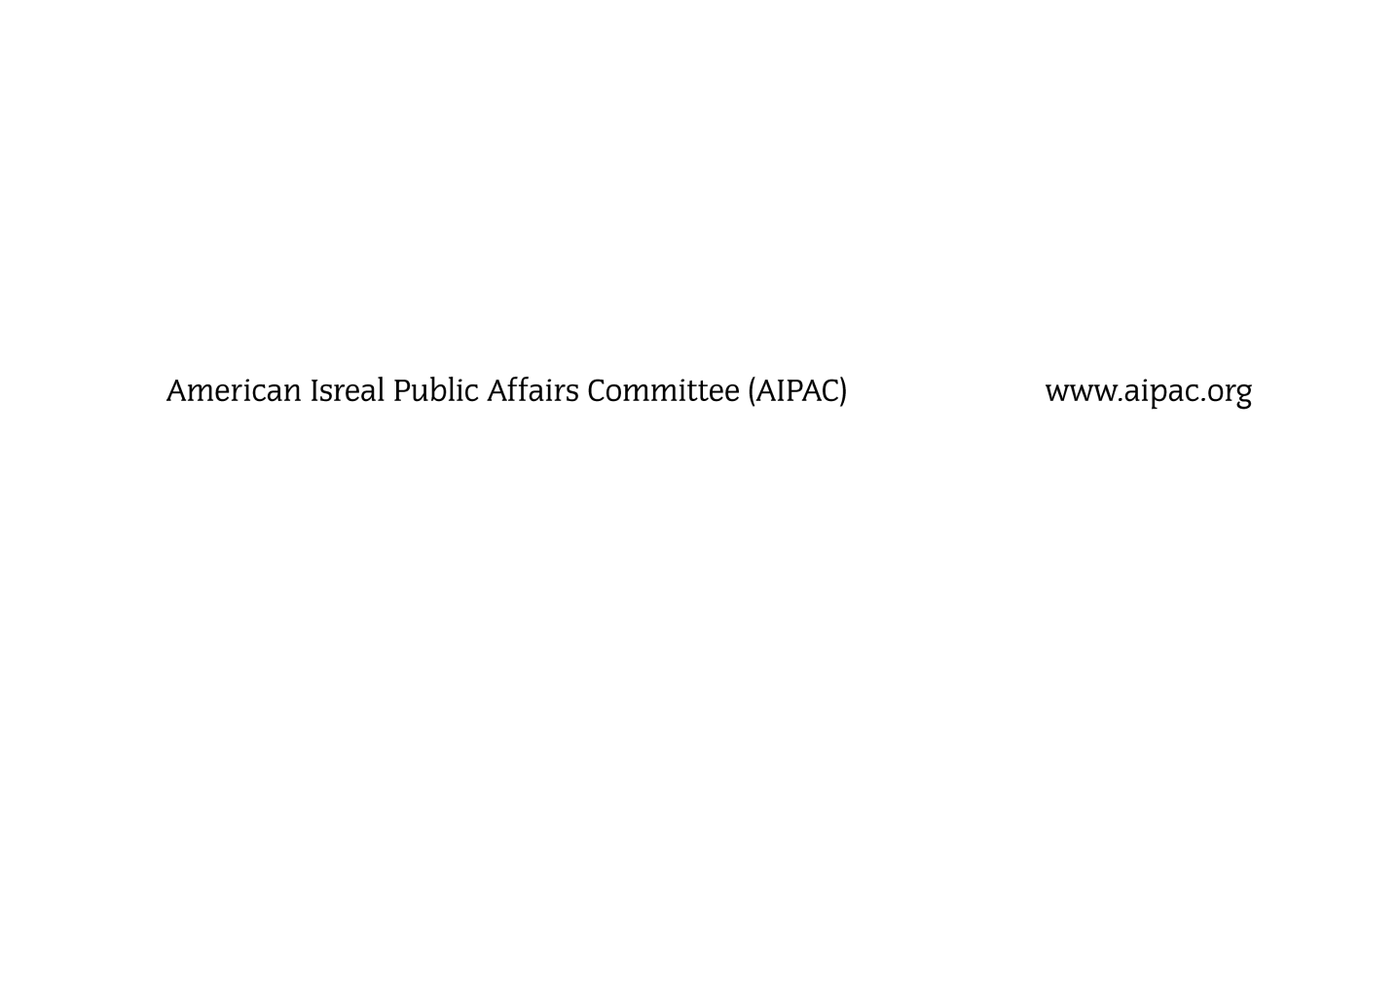

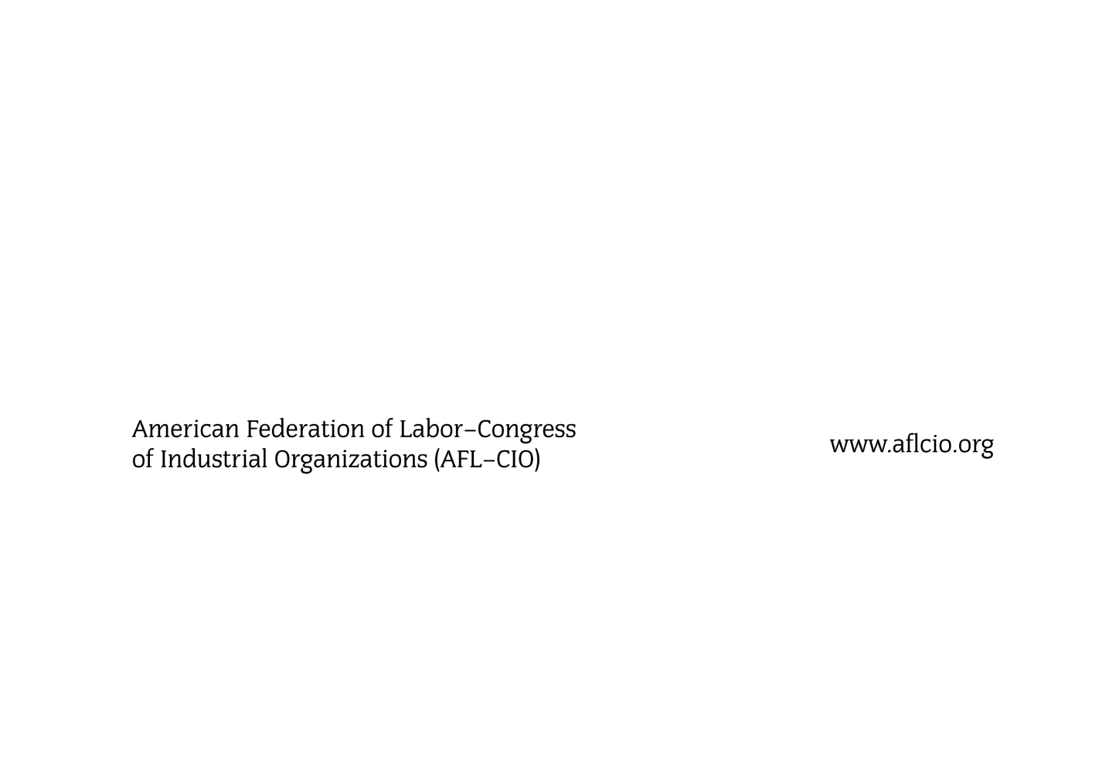
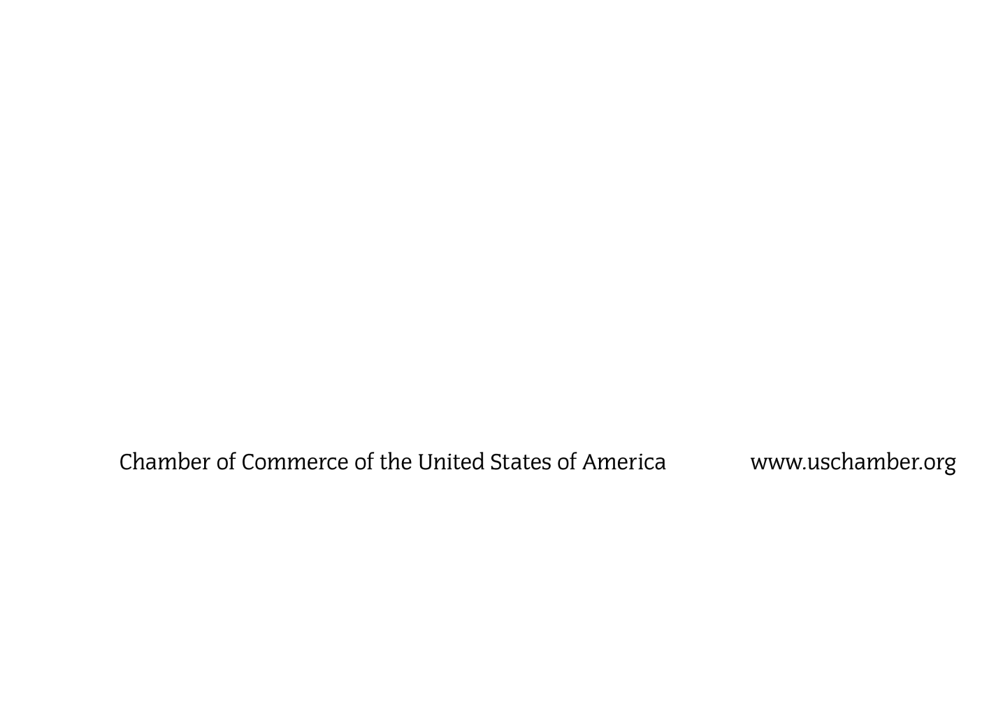
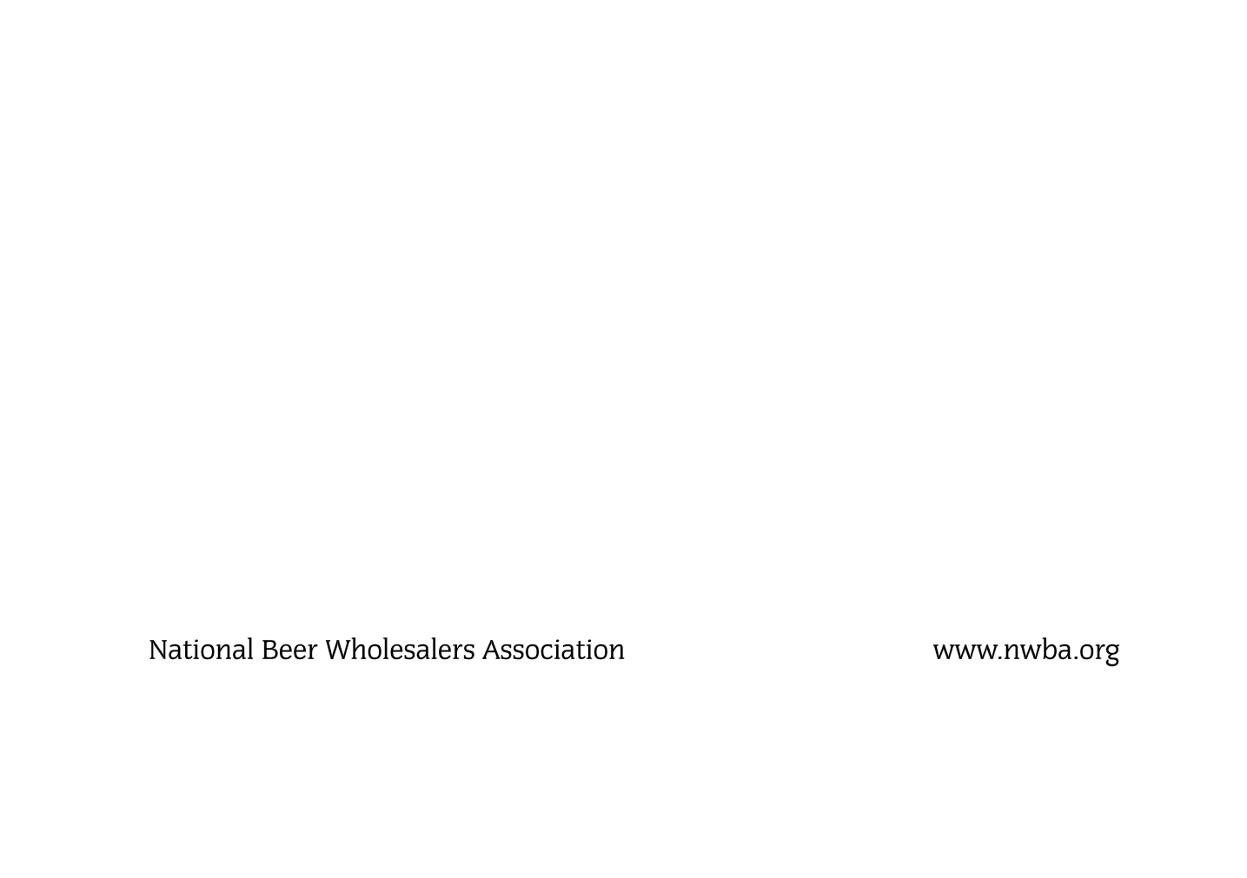
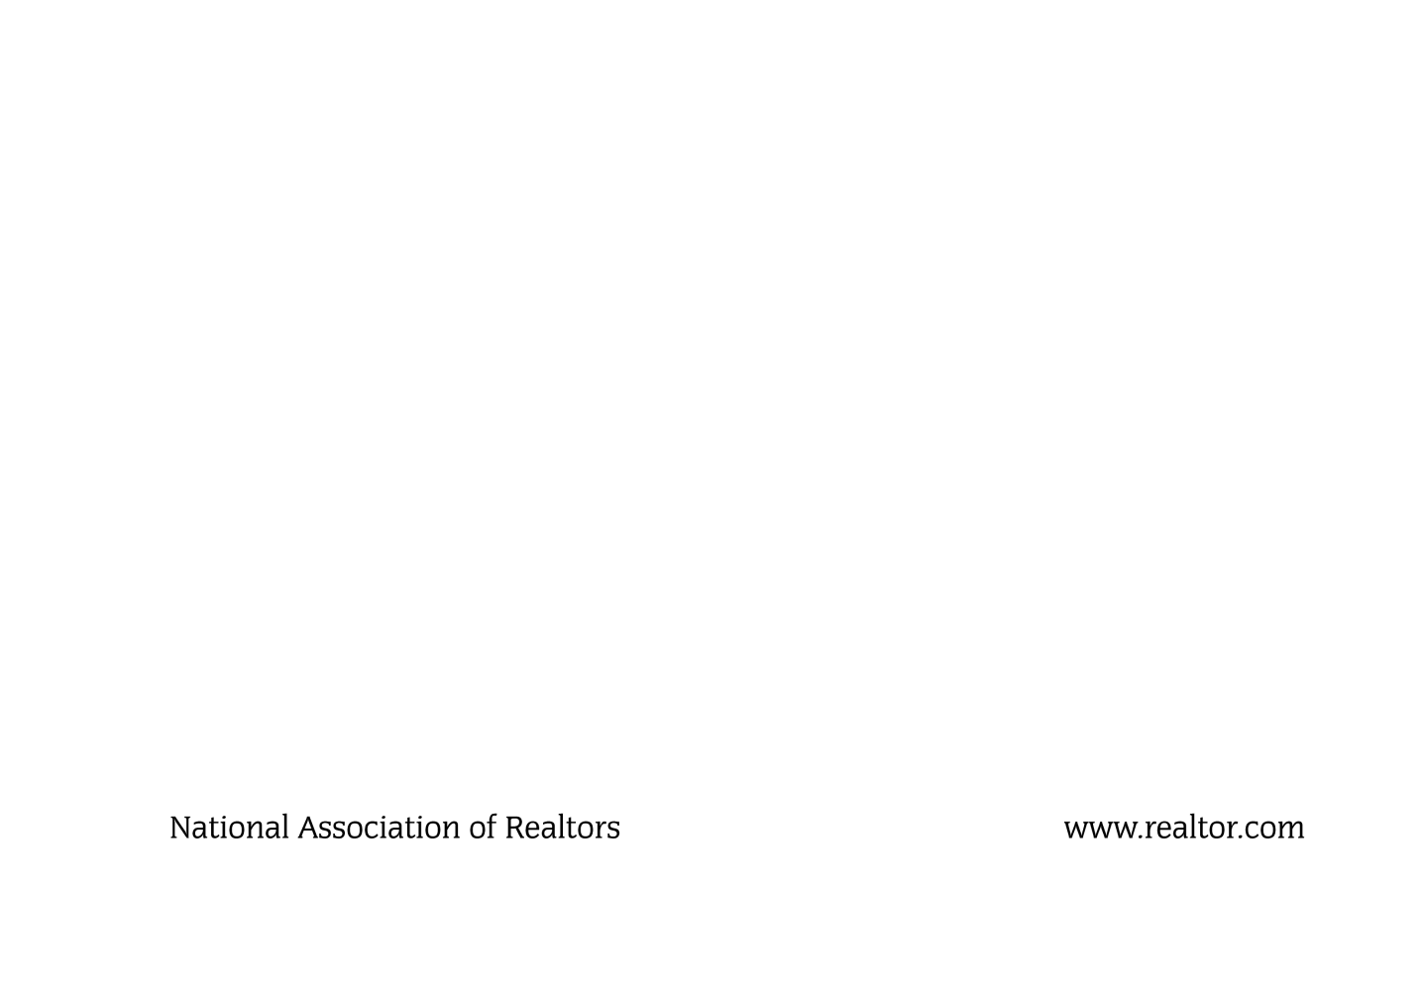
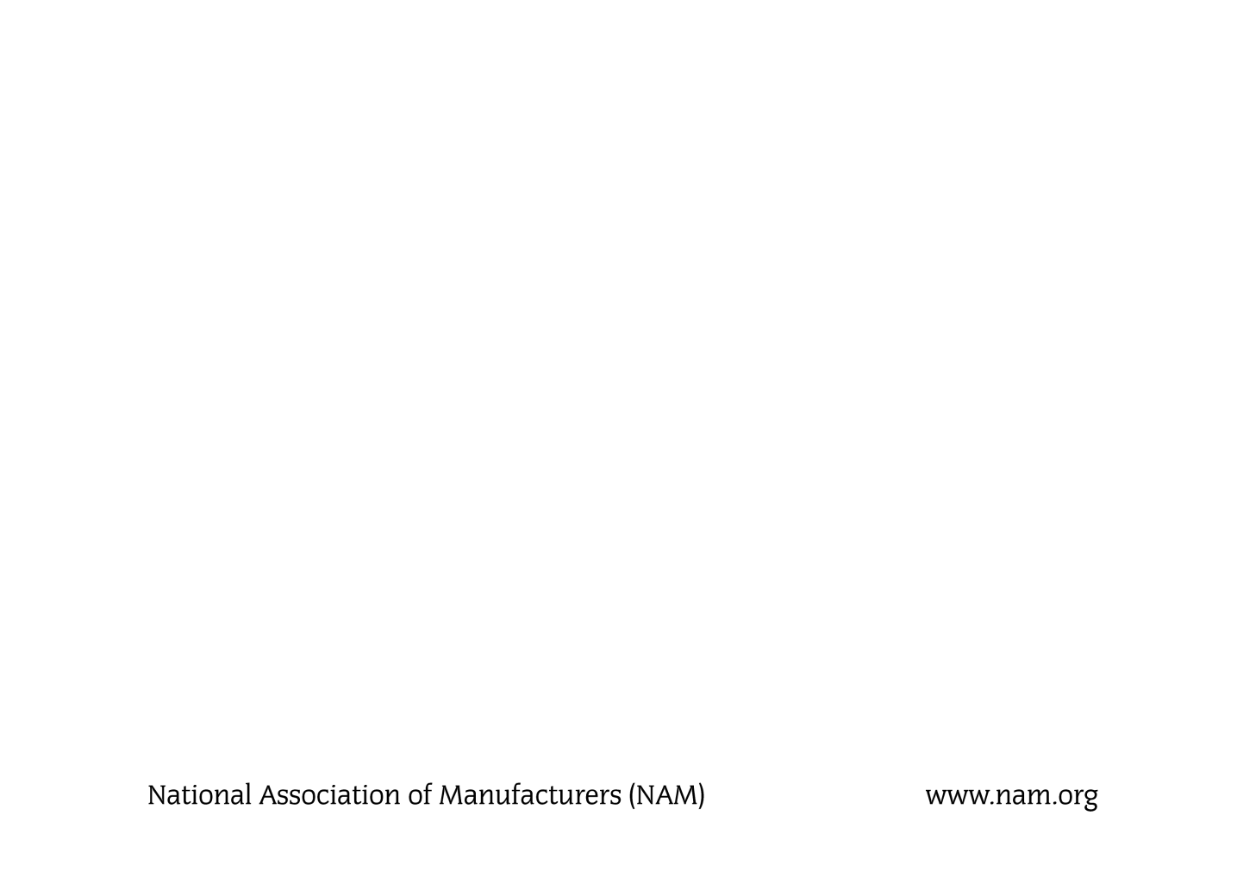
Fortune’s “Power 25”
The 10 Most Effective
Interest Groups

Slide 10
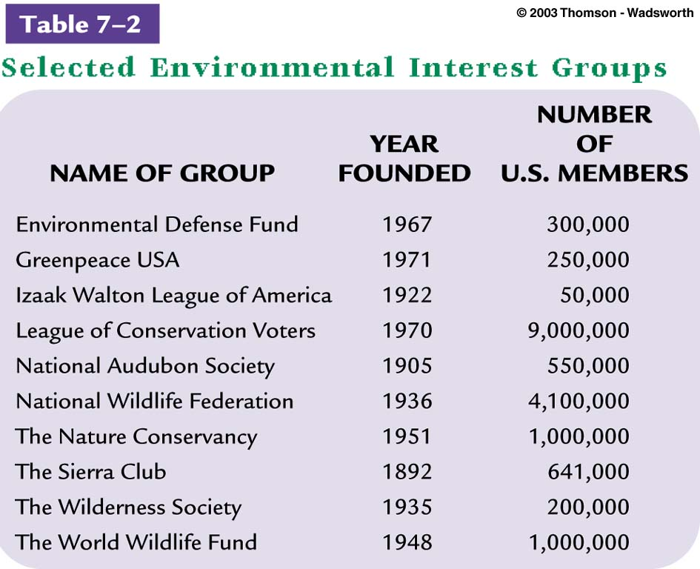

Slide 11

Interest Groups and American Politics (Pluralism)
From the Perspective of Madison
From the Perspective of Tocqueville
Critics of Pluralism argue that a new condition,
“hyperpluralism” has developed since the 1970s,
In which the proliferation of interest groups has led
to gridlock.

Slide 12
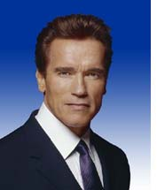
The Governor vs. the Special Interests
“ The biggest problem that we have is that California is being run now by special interests. All of the politicians are not anymore making the moves for the people, but for special interests and we have to stop that."

Slide 13
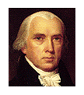
Perspectives on Interest Groups
Pluralism is dangerous
“By a faction, I understand a number of citizens, whether
amounting to a majority or minority of the whole, who are
united and actuated by some common impulse of passions,
or of interest, adverse to the rights of other citizens, or to
the permanent and aggregate interests of the community.”
James Madison

Slide 14
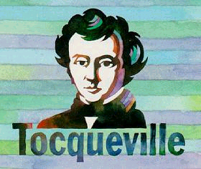
Pluralism Makes American democracy stronger
ASSOCIATIONS
"Americans of all ages, all stations of life, and all types of disposition
are forever forming associations...In democratic countries knowledge
of how to combine is the mother of all other forms of knowledge; on its
progress depends that of all the others."
Author of
Democracy in America

Slide 15
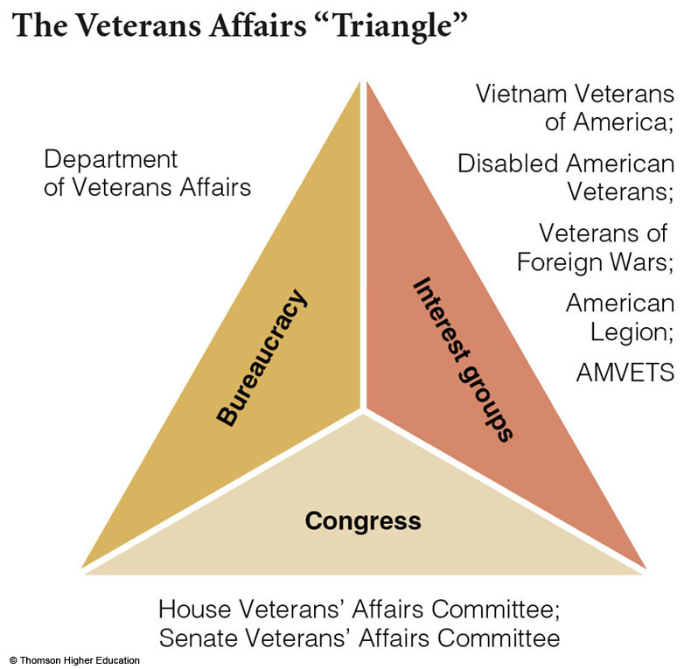
Fig. 14-1, p. 472

Slide 16
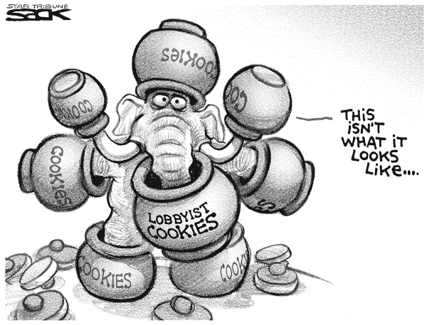
What is the message of this cartoon? Do you agree? Discuss
alternative points of view as part of your argument.

Slide 17
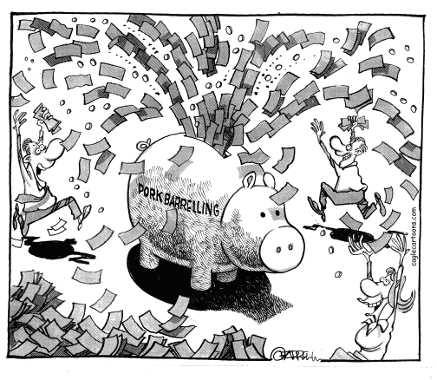

Slide 18
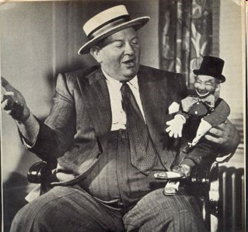
Artie Samish-CA Lobbyist
“Said the Big Man, “And how are you today, Mr. Legislature?”

Slide 19
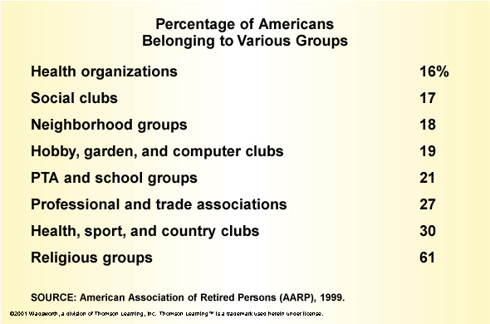
A Nation of Joiners…

Slide 20
Interest Groups Defined
Any group that seeks to influence public policy
  Synonym: pressure group, special interest groups

Slide 21
Types of Interest Groups
Labor
  United Auto Workers
  American Federation of Labor
Business
  Chambers of Commerce
  Business Roundtable
Citizen
  Consumer groups, e.g., Common Cause
  Single-Issue Groups, e.g., MADD

Slide 22
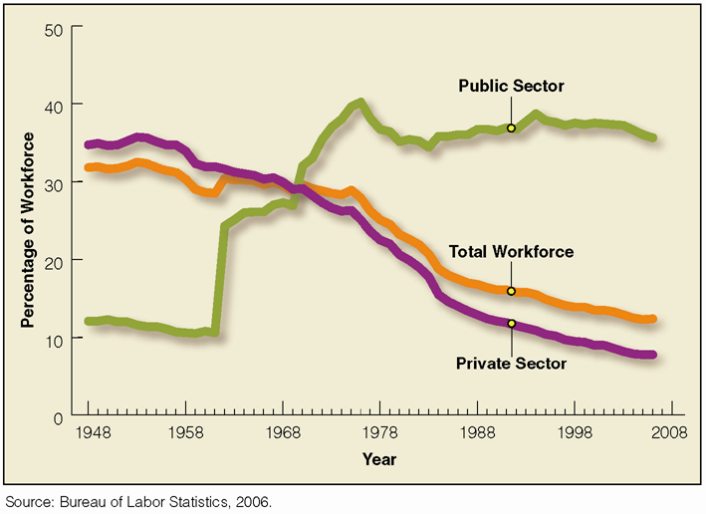
Decline in Union Membership, 1948 to Present

Slide 23

How do Interest Groups attract New Members?
Purposive incentive (persuade people about the virtue of the cause)
Material incentive: benefit (ex. Towing service)
(side payment)
Solidary incentives (companionship)

Slide 24
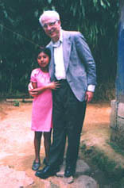
Childreach: Helping stop hunger one child at a time
Focus on interest groups: Stopping World Hunger
7 billion people on this planet
1 billion are malnourished
100 million are children
10 million people die of hunger each year
6 million are children
( a child can be fed for 19 cents a day by the UN)
Source: United Nations, World Food Program
Child Sponsorship

Slide 25
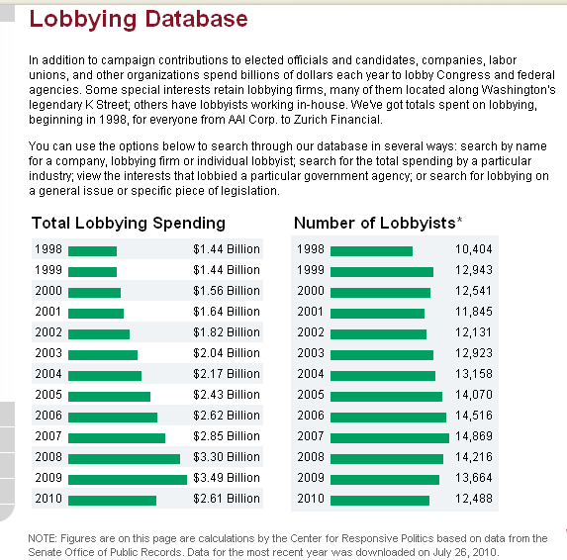
What do interest groups do?
Lobbying: pressuring government to change policy
Source:
Center for
Responsive
Politics

Slide 26


Tactics of Interest Groups
Direct Lobbying
  Giving Money
  Making Personal Contacts
  Lobbying the Bureaucracy
  Lobbying the Courts (Litigation)
  Providing Expertise
    Testifying at Hearing

Slide 27
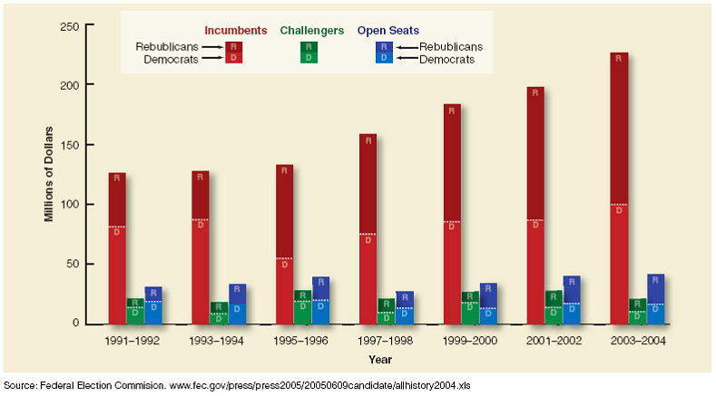
PAC Contributions to Congressional Candidates, 1991–2004

Slide 28
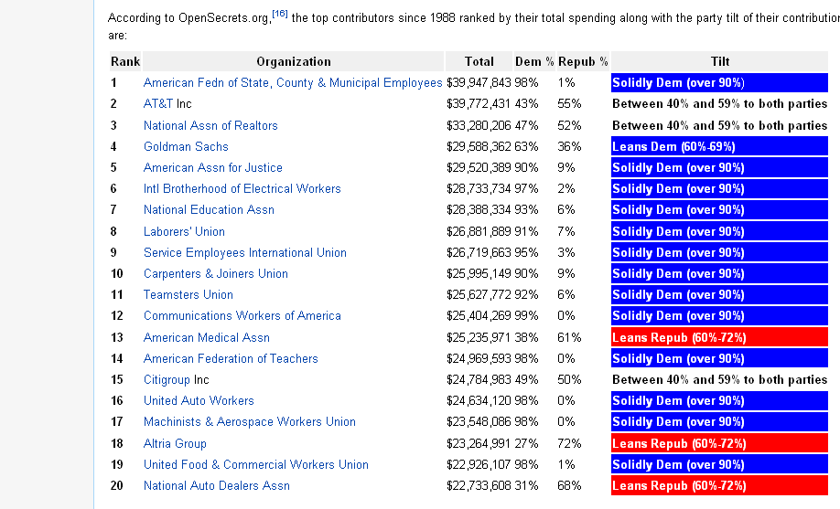
Top PACs and their Ideological Leanings.

Slide 29
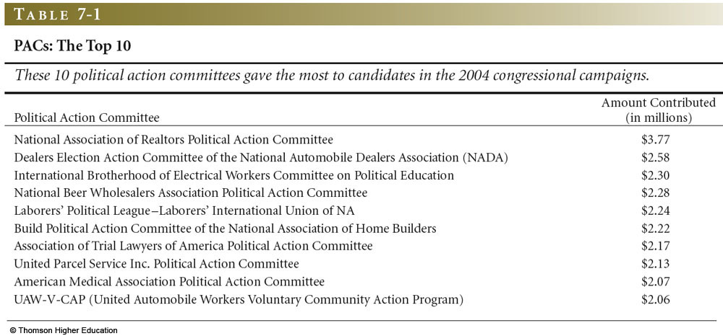
Top Ten PACs: 2004 general election
Table 7-1, p. 214

Slide 30
Indirect Lobbying
Mobilizing the Grass Roots Supporters
Molding Public and Elite Opinion
Coalition building

Slide 31
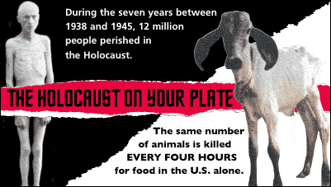
Promoting Animal Rights
People for the Ethical Treatment of Animals (PETA)
Hyperlink: Protecting Circus Animals
From the PETA website:
Is the above picture obscene?

Slide 32
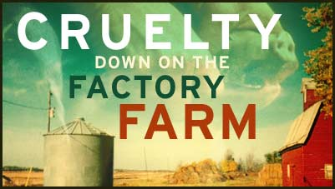
Protest and Civil Disobedience
Follow the example of the Civil Rights Movement
  Sit-ins
  Boycotts
Media attention
People for the Ethical Treatment of
Animals

Slide 33
Examples of Civil Disobedience
A town has an ordinance that states that a residential property owner or renter may not have more than three animals on her property. A residential property owner in that town has three animals and wants to take in several strays. She believes that the ordinance is morally wrong and wants to call attention to that belief. She consults an attorney and learns that the penalty for violating the ordinance is $500.00. The attorney correctly advises her that the ordinance does not violate the federal or state constitution and does not violate state or federal statutes or regulations. Nonetheless, the resident purposefully violates the ordinance, then calls the authorities to inform them of her "crime." She is fined $500.00, which she pays. Subsequently, she tells a local television program about the event, explaining why she believes the ordinance is unfair and should be struck down. This is civil disobedience.
Source: http:// animal-law.org

Slide 34
Public Goods
Public goods are nonexclusive benefits: once provided to one or some, they are provided to all.
  National Defense A Group Project
  Clean Air A Labor Union
Public Goods provision suffer from the free rider problem
  How can the free rider problem be overcome?
  Free Rider problem: the problem that people believe that other people can address an issue and hence the problem is not solved
Consequence: large groups have a harder time forming than small groups—do large groups then have a harder time influencing government?

Slide 35
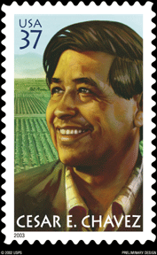
United Farm Workers
Founder: Cesar
Chavez
(March 31, 1927 – April 23, 1993)
Issued April 23
2003
March 31 Cesar Chavez holiday in CA

Slide 36
Farm workers
850,000 farmworkers in the state
Contract labor
Not subject to the minimum wage
Average Wage: $6500 a year
Average Wage: $8.29 an hour (in 2000)
United Farm Workers represent about 30,000 workers today
Pack of Strawberries costing 1.60 at store, .60 goes to farmer and
About .l0 to the laborer.

Slide 37
Example of UFW contract (2001)
Watsonville Berry Co. contract with berry workers in Oxnard (750 workers)
Company Paid: medical and dental, six paid holidays, life insurance, job security, a seniority system and a grievance procedure
The contract provides an average wage increase from 7 percent to 15 percent over three years, depending on job classification. For example, workers who do general labor will receive a 50-cent raise to $6.75 an hour, pickers, most of them immigrants from Mexico, will earn $8.50 to $10 an hour, up from a maximum of $8.25.

Slide 38
United Farm Workers: Strategies for Organizing
Picketing—
Unite the different ethnicities who worked in the fields
Credit Union started
Guerrilla theater
Publicity—Kennedy visit
UFW received help from the AFL-CIO
Promoted nonviolent tactics
a. encouraged women to participate
Church involvement –Cardinal Mahoney
March to Sacramento

Slide 39
UFW
Informational leaflets
Union meetings: persuasion
Symbol of the eagle: ethnic pride
Multi-ethnic union

Slide 40
UFW: Strategies for Organizing
Protesting: Picketing
Nonviolent Civil Disobedience
Strikes (during harvest time)
Media
Passing out pamphlets
Religious leaders helping strikers as well as employers

Slide 41
Pros and Cons of Unions
Higher wages
Fewer hours
Better training
Better Job Security
Less Freedom for Employer
Unions are exercising monopolistic power
  Representing all workers
Consumer products may become more expensive
Strikes and other labor actions may disrupt economy

Slide 42
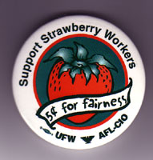
United Farm Workers
Describe the actions of the United Farm Workers. Do you believe that more farm workers should be unionized?
Strikes/picketing
Organizing the union
Stopping the scabs from crossing the picket line
Philosophy of nonviolence
Marches
fast

Slide 43
United Farm Workers
Describe the actions of the United Farm Workers. Do you believe that more farm workers should be unionized?

Slide 44
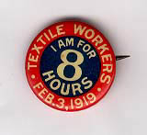


Slide 45
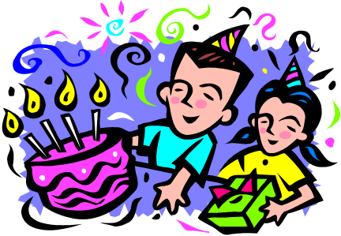
Issues
What are interest groups?
What do they do?
What effects do they have on American democracy?
What, if anything, should be done to control interest groups?

